Slide 1
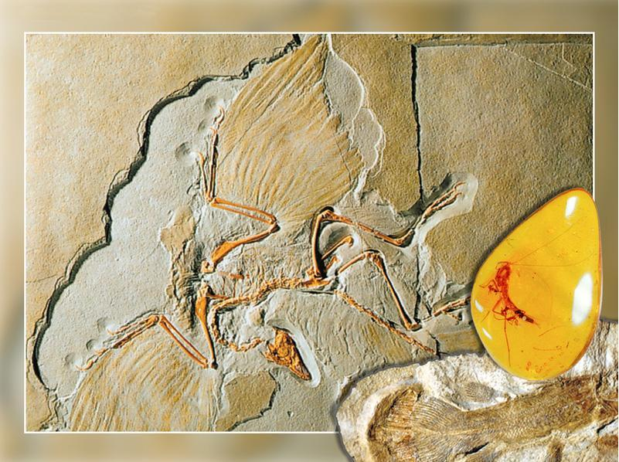
Patterns of Evolution page 184

Slide 2
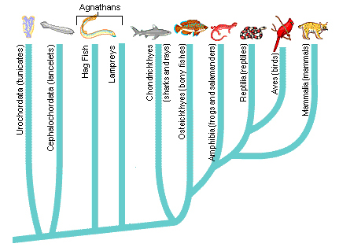
Phylogenetic Trees
These are diagrams to show evolutionary relationships between organisms.
They are largely based on fossil records and the study of DNA
The one you are about to see shows relationships in vertebrate evolution

Slide 3
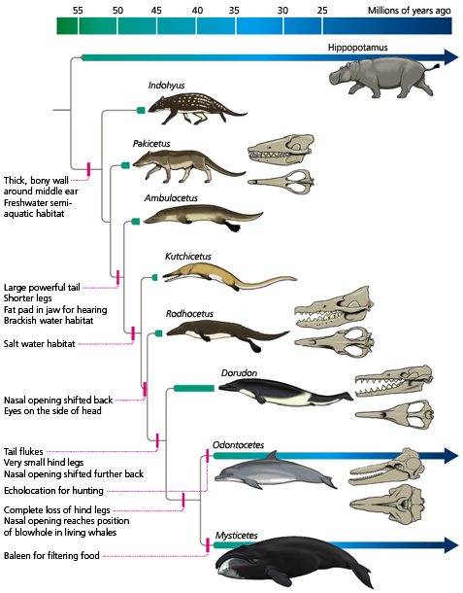
Phylogenetic
Trees
The one here shows relationships in whale evolution
(since they have one of these on page 184)

Slide 4
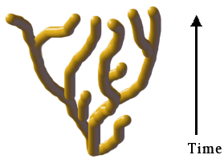
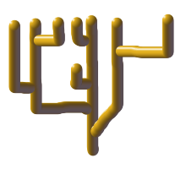
Rate of evolutionary change (p185)
Gradualism
The pace of evolutionary change is gradual and steady.
The fossil record should show a range of transitional forms
Punctuated Equilibrium
Species stay the same over many generations with short bursts of evolution in between, stimulated by environmental change
Fossil record shows this for many species.

Slide 5
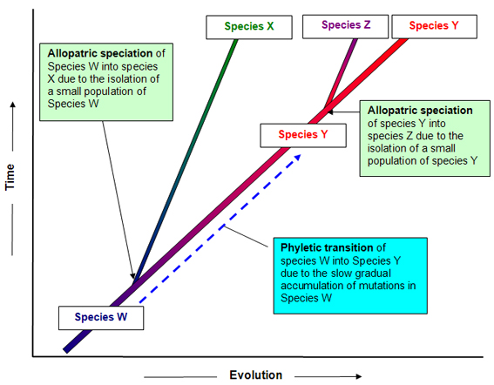
Gradualism

Slide 6
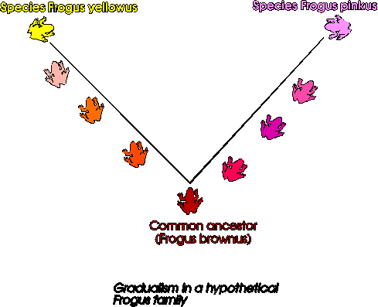
Gradualism

Slide 7
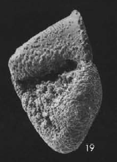
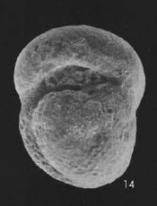
Gradualism
This example of gradualism in Globorotalia conoidea is in the text on page 185. Foramaniferans are tiny planktonic organisms
Side view of
Globorotalia conoidea
(around 7 millon yrs ago)
Side view of
Globorotalia inflata
(Present day species)
WOW!

Slide 8
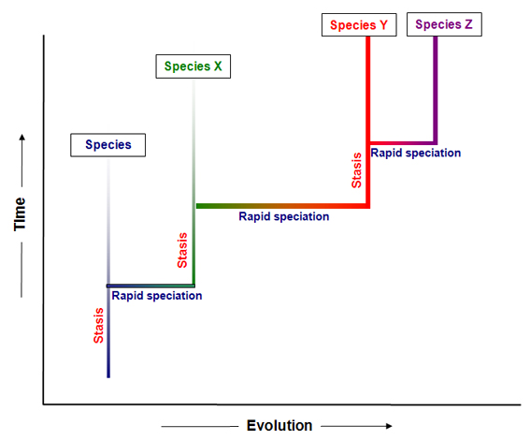
Punctuated equilibrium

Slide 9
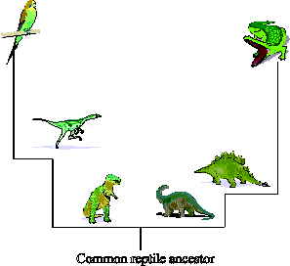
Punctuated equilibrium

Slide 10
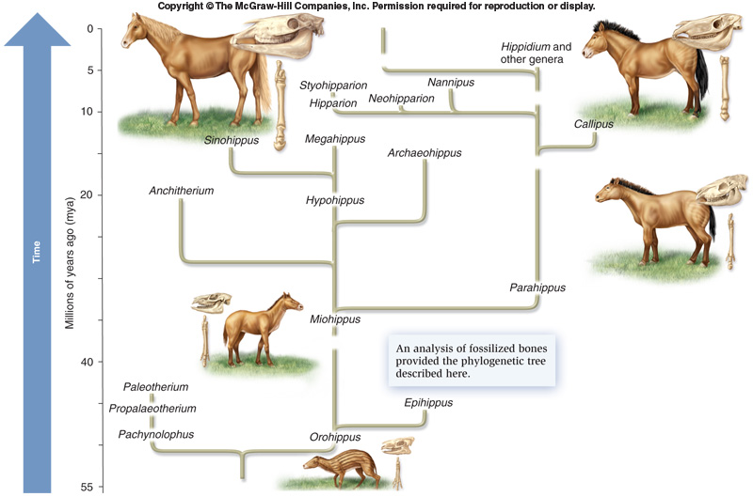
Evolution of horses

Slide 11
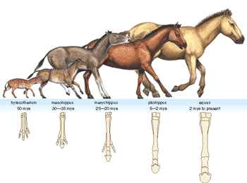

Slide 12
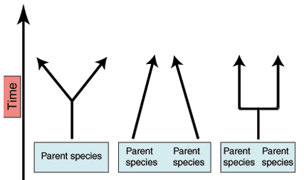
Patterns of Evolution (p188)
Divergent
Convergent
Parallel

Slide 13
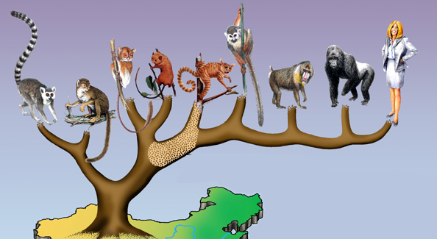
Divergent Evolution
Formation of two or more new species from one common ancestor

Slide 14
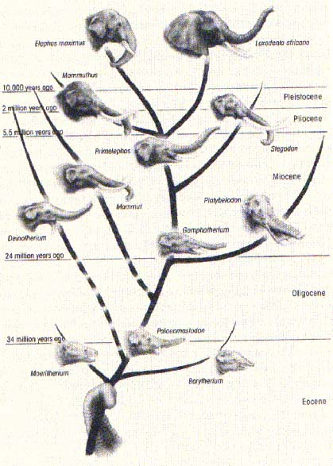
Evolution of the elephant

Slide 15
Adaptive Radiation
The divergent evolution of several different forms from one original type.
This may be one species giving rise to 5 or more species.
OR it may be one original type of organism giving rise to thousands of different species of different genera, families, orders and so on.
  E.g. An ancestral reptile giving rise to all mammals

Slide 16
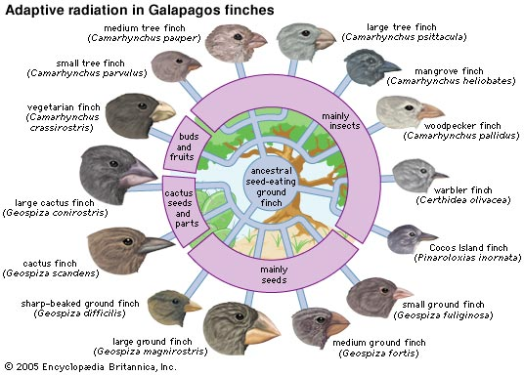

Slide 17
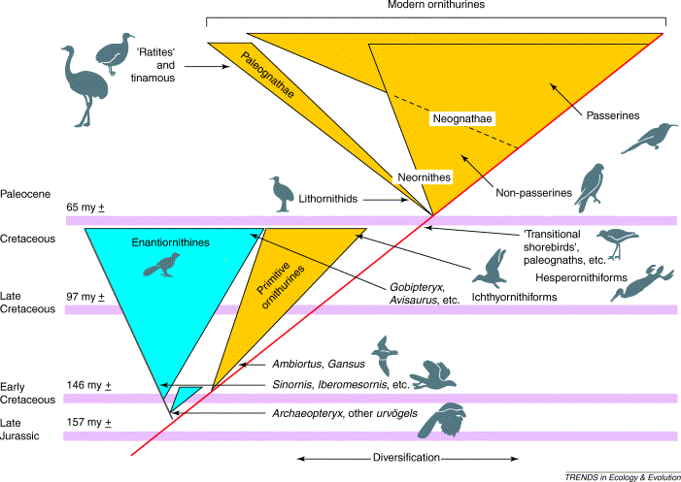
Radiation in the Birds

Slide 18
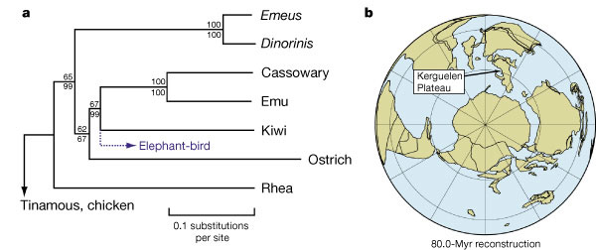
Radiation in Ratites

Slide 19
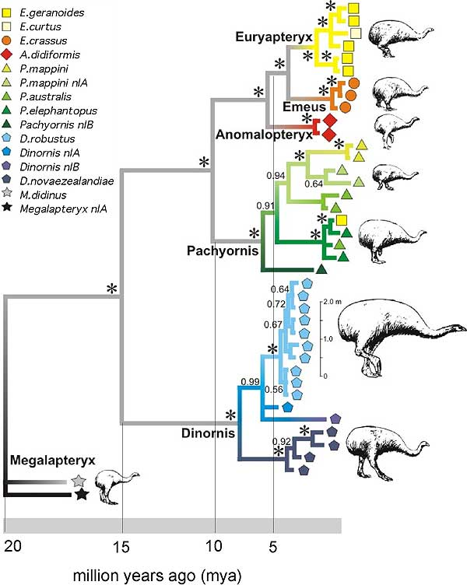
Radiation of the moa

Slide 20
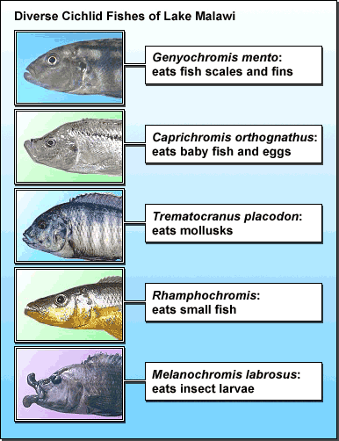
Adaptation to different niches by cichlids of Lake Malawi.

Slide 21
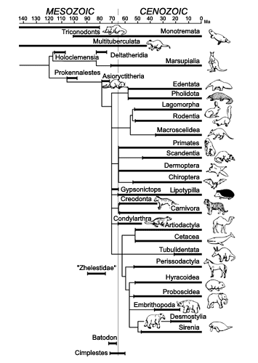
Adaptive radiation of the mammals

Slide 22
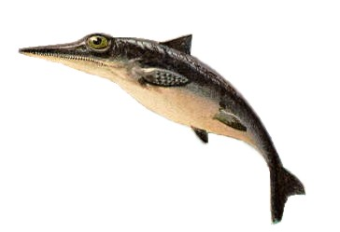
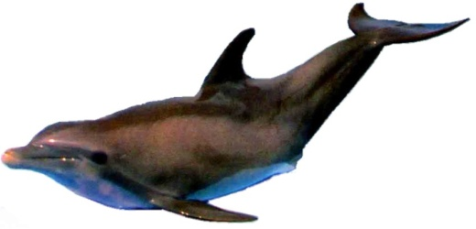
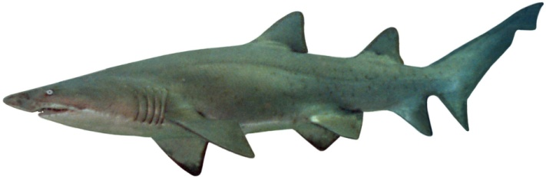
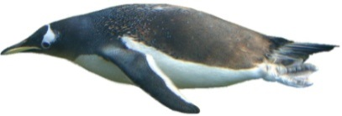
Convergent Evolution (p190)
The evolution of similar adaptive features in unrelated species that have adapted to the same environment
E.g. sharks (fish), ichthyosaur (reptile), dolphins (mammal) and penguins (bird) independently evolved a similar, streamlined shape suitable for a fast aquatic predator.

Slide 23
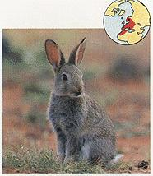
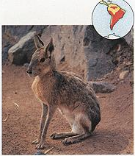
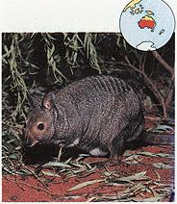
Convergent Evolution of Rabbity things
The Australian “banded hare” is actually a wallaby, a marsupial that is a member of the kangaroo family.
  The European Rabbit.
  Placental mammal,
  Order lagomorpha
The Patagonian hare or cavy.
Placental mammal,
Order rodentia

Slide 24
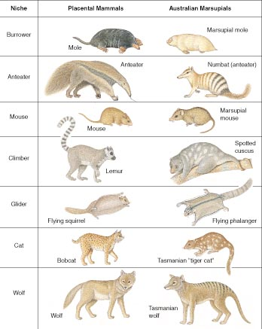
Convergent evolution between placental and marsupial mammals

Slide 25
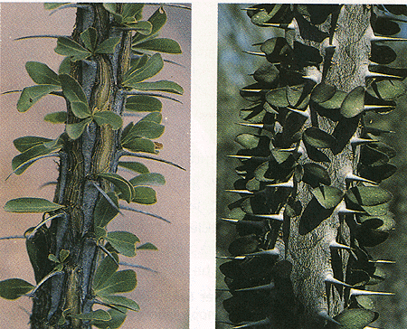
Plants do it too
Convergent structures in the ocotillo (left) from the American Southwest, and in the allauidia (right) from Madagascar.

Slide 26
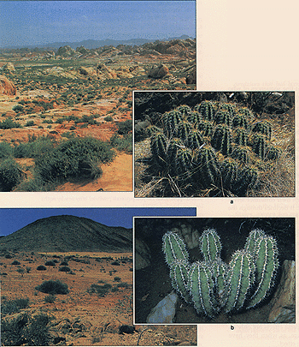
Similar body shapes and structures have evolved in the North American cacti...and in the euphorbias in Southern Africa

Slide 27
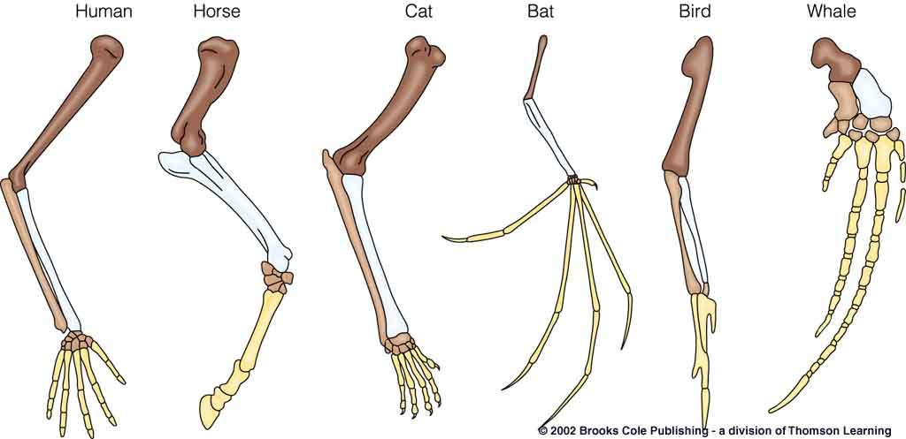
Homologous structures
E.g. the vertebrate pentadactyl limb
Differently shaped for different uses but adapted from a common ancestral structure.

Slide 28
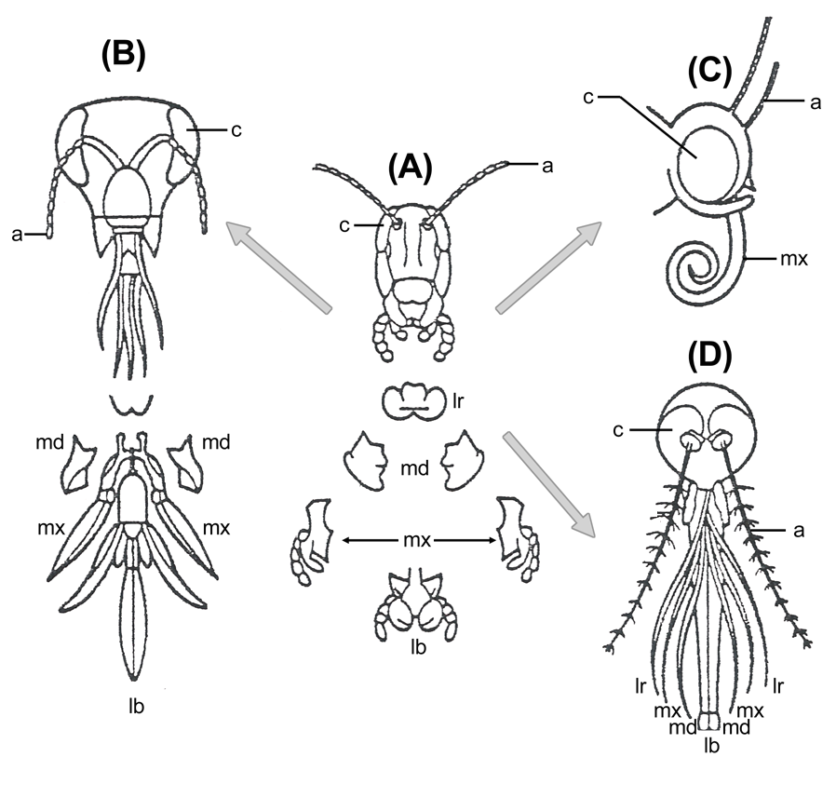
Insect mouth parts

Slide 29
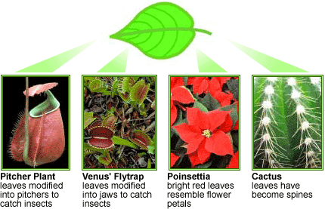
Homologous structures
Leaves can be adapted in many ways

Slide 30
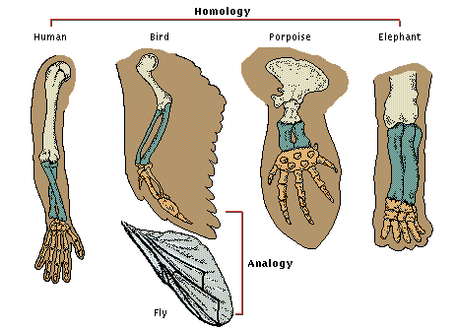
Analogous structures
The insect wing has the same function as a bird wing but has a different evolutionary origin.

Slide 31
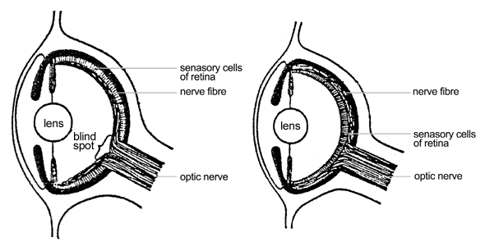
Vertebrate eye
Octopus eye

Slide 32
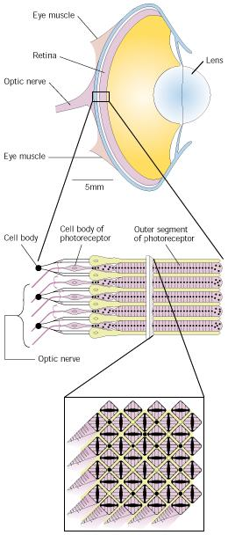
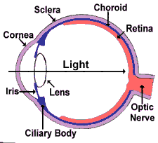


Slide 33
Parallel Evolution (p190)
(NOT mentioned in the standard ??)
This is where closely related species evolve similar features not present in the ancestral form.
E.g. :
Loss of wings of related bird or insect species on off-shore islands
Different species of NZ buttercups have evolved similarly shaped seeds

Slide 34
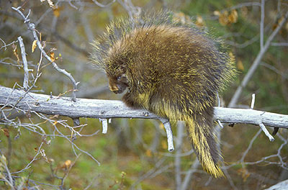
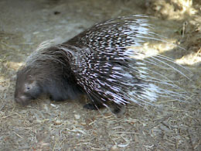
Parallel Evolution
The porcupines below had a common ancestor without quills but both evolved quills independently
North American Porcupine
African Porcupine

Slide 35
Co-Evolution (p193)
Genetic change in one species in response to genetic change in another species.
This can be between:
  Mutualism, cooperative species – e.g. flowers and pollinators.
  Competitors – e.g. notch and window caterpillars.
  Some exploitation relationships, e.g. plants and herbivores, predator and prey or parasite and host.

Slide 36
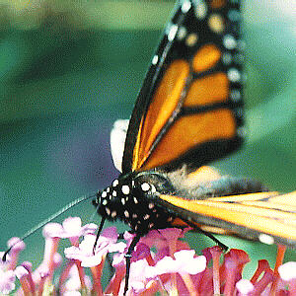
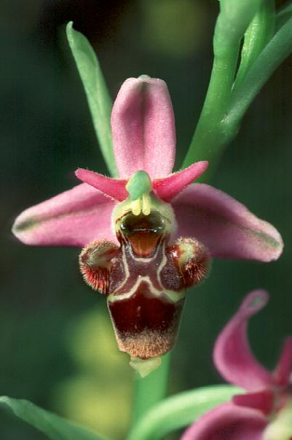
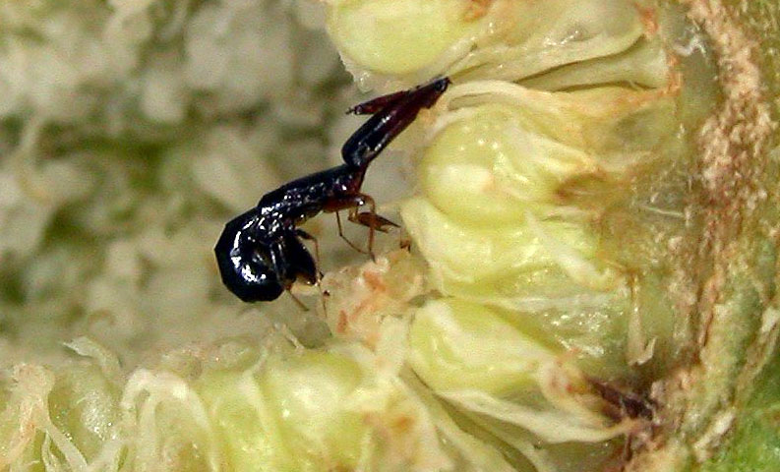
Pollination

Slide 37
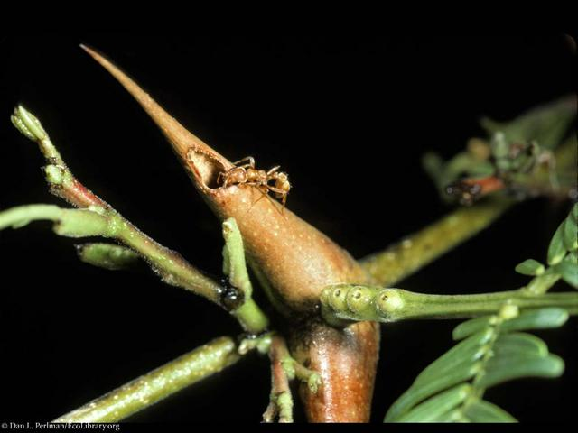
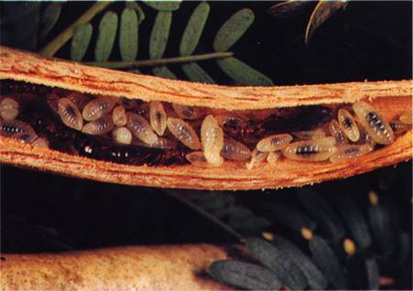
Ants and acacia have evolved to help each other

Slide 38
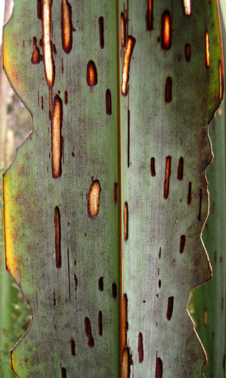
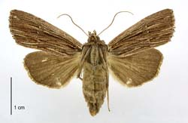
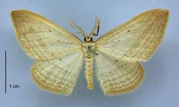
Notch and window caterpillars have co-evolved to reduce competition
Adult of notch caterpillar
Adult of window caterpillar

Slide 39
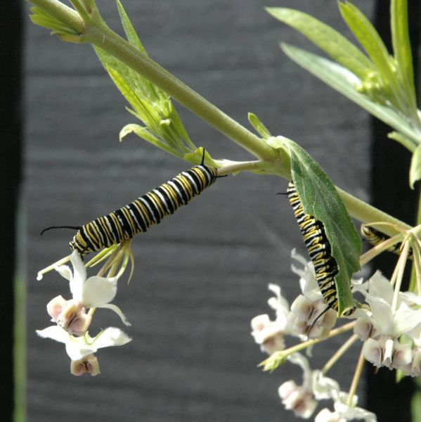
Co-evolution in herbivores
The swan plant eaten by monarch caterpillars is toxic. The caterillars have evolved immunity and even store the toxin.

Slide 40

Co-evolution in herbivores 2
A Plain Tiger caterpillar making a moat to block highly toxic defensive chemicals of the “apple of Sodom” before feeding.

Slide 41


Co-evolution in predation
Co-evolution also occurs between predator and prey species as in the case of the Rough-skinned Newt and the common garter snake. In this case, the newts produce a potent nerve toxin that concentrates in their skin. Garter snakes have evolved resistance to this toxin through a set of genetic mutations, and prey upon the newts. The relationship between these animals has resulted in an evolutionary arms race that has driven toxin levels in the newt to extreme levels.

Slide 42



Co-evolution in parasitism
Researchers have found co-evolution between parasitic worms and fresh water snails in N.Z. As the snails evolve defences, the worms overcome them. This results in fluctuating numbers of snails and parasites.

Slide 43


